Slide 1
Population and Emerging issues of Development
UNIT 3

Slide 2
Growth of world’s population
The population of a country or any other area is the total number of people who live on it.
It is a driving force in development.
Greater the number, greater is the utilization of natural resources.
Efficiency and productivity of people
Population of the world is increasing at alarming rate in recent years which is known as “Population Explosion”.

Slide 3
Thoma Robert Malthus principle of overpopulation.

Slide 4
Population density
Population density is a measurement of the number of people in an area. It is an average number. It is calculated by dividing the total number of human population by area. It is also shown as the number of persons per square kilometer or mile.
Factors affecting population density
Landform
Natural resources
Climate

Slide 5
Density areas
1. Thinly or Sparsely populated areas: (Less than 10 persons per sq. km)
A) Tropical deserts= Scanty rainfall. Scarcity of water.
Sahara of North Africa, California and Arizona of North America, Atacama of South America, Kalahari of South Africa, The great Australian Desert, Thar desert of India. Saudi Arabian desert.
B) Cold deserts= Very low temperature
North Canada, Alaska, Greenland, Europe, Siberia, Antarctica.

Slide 6
C) Hot and humid climate= Very high temperature and high rainfall. Climate is unhygienic.
Amazon basin of South America and Congo basin of Africa, Borneo, New Guinea.
D) Mountain areas= Snow cover, poor soil
Rocky mountain of North America, Andes mountain of South America, Himalayas, Plateau of Tibet in Asia, Alps mountain
2 Moderately populated areas (10-200 persons per sq. km.)
Asia, Europe, Eastern parts of U.S.A. ,
Tropical western Africa, Eastern Europe, Central China , Deccan plateau of India.
People are dependent on seasonal agriculture.

Slide 7
3. Densely populated areas (200 persons per sq. km.)
Climatic conditions are favorable for high production of foodstuff or raw material or where commercial activities are developed.
South Asia= India, Pakistan, Bangladesh, Sri Lanka
East and South east Asia= China, Japan, North Korea, South Korea
North western Europe= Denmark, Holland, France, Spain
North eastern part of USA and south eastern part of Canada.
Rich mineral wealth, abundant supply of power.

Slide 8
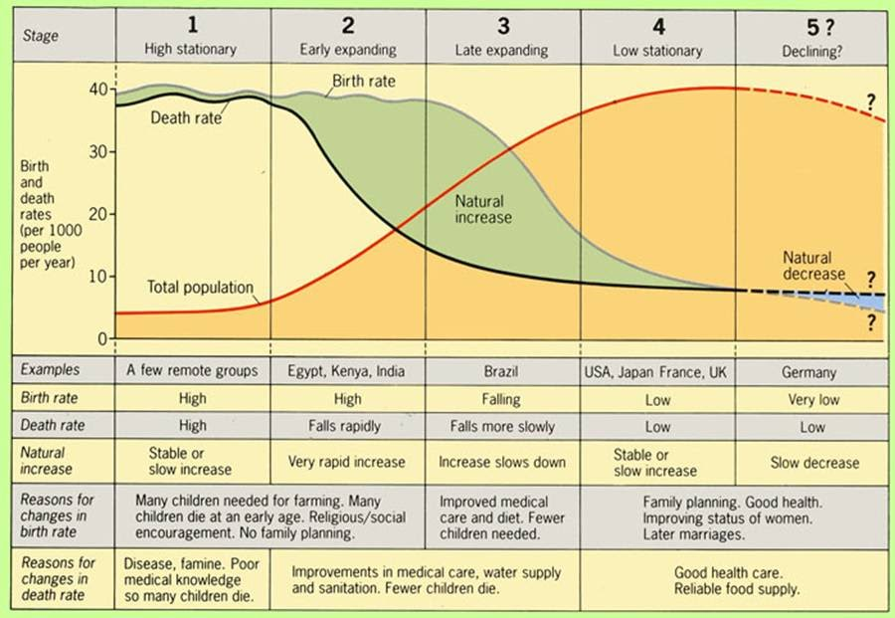
Demographic transition model

Slide 9
Effects of population growth
Degradation of environment
Conflicts and wars
Rise in unemployment
High cost of living

Slide 10
Causes of population explosion
Higher birth rates and higher fertility rates
Early marriages and universal marriage system
Poverty and illiteracy
Age old cultural norm

Slide 11
Effects of population explosion
Unemployment
Poor standard of living and malnutrution
Poverty
Agricultural resources
Slow growth of industrial sector
Orthodoxy
Political problems
Environmental degradation
Tensions

Slide 12
Measures taken to control population growth
Approaches to population policies of India
Family planning programme 1952
The clinical approach
Nationwide family planning programme
The extension approach
Changes in behavior and attitude of people.
The integrated approach
Maternal and child health services
The camp approach
Family camps for sterilizations.

Slide 13
Human population and Environment
Impact on landforms
Dustbowl
Modification of atmosphere
Pollutants in the atmosphere
Changes in atmospheric gas levels
Modification of Ecosystem
Eutrophication
Effect on individual species

Slide 14
Environment and Human Health
Physical hazards and health
Chemical hazards and health
Biological hazards and health

Slide 15
Human Development Index
HDI report introduced a new way of measuring development by combining indicators of life expectancy, educational attainment and income into a composite human development index.
It is means to higher productivity. Government must invest in health, education and in other related sectors.
It reduces poverty and increases greater social stability.
It lowers the family size by reducing reproduction.
It contributes towards good physical environment by arresting deforestation, soil erosion etc.

Slide 16
Dimensions of Human Development
1. Long and healthy life
The long and healthy life dimension is measured by life expectancy at birth. The life expectancy at birth is a statistical measure that an average individual is expected to live based on certain demographic factors such as the year of birth and current age.
2. Education
This is a second dimension in the HDI. The indicators of education are the expected years of schooling and the mean years of schooling. According to the UN, the average maximum years of schooling is 18 years, while the mean maximum years of schooling is 15 years.
3. Standard of living
The standard of living is usually measured by the gross national income (GNI) per capita. The GNI indicates the total domestic and foreign output created by the residents of a certain country.

Slide 17
India ranks 119th out of 169 countries in human development in the world.

Slide 18
Indian states with HDI

Slide 19
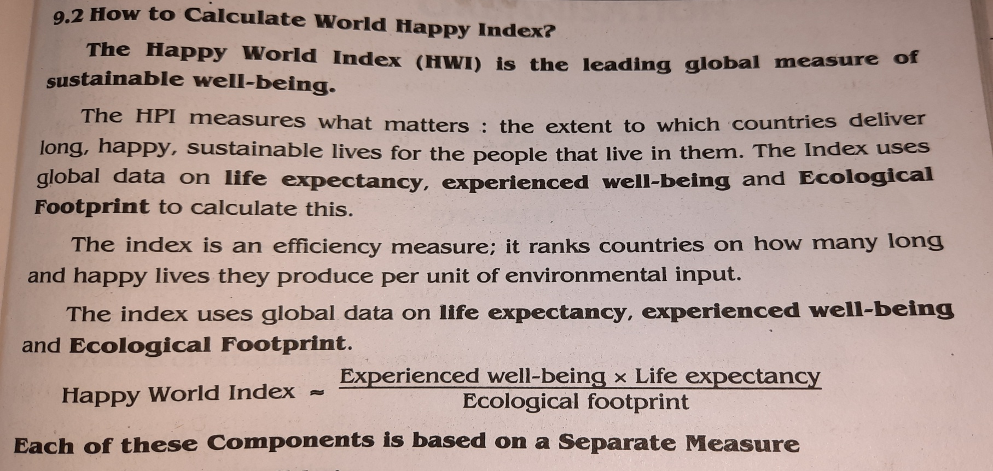
World happiness index
World happiness report is a measure of happiness published by United Nations Sustainable Development Solutions Network.
Resolution was passes in 2011 by UN general assembly inviting countries to measure the happiness of their people.
The first report was released on April 1, 2012 as a foundation text for the meeting.

Slide 20
1. Experienced well being
It is to know how well someone’s life is going. It is assessed using a question called the “Ladder of Life” from the Gallup World Poll, where “0” represents the worst possible life and 10 the best possible life.
2. Life expectancy
It includes a universally important measure of health- life expectancy.
3.Ecological Footprint
A measure of resource consumption. It is a per capita measure of the amount of land required to sustain a country’s consumption patterns, measured in terms of global hectares.

